Slide 1


E-COMMERCE PROGRESS

Slide 2
PROGRESS

Slide 3







SOCIAL MEDIA

Slide 4
SOCIAL MEDIA KPI
POLLING
BRAND AWARENES : IMPROVEMENT (%) GROWTH OVER COMPETITOR
1000 + PARTICIPANT
FANS FACEBOOK GROWTH : 100 % IMPROVEMENT EACH MONTH ( 2 ACTIVATION A MONTH )
TWITTERS FOLLOWER : IMPROVE 100% FOLLOWERS EACH MONTH ( 2 ACTIVATION A MONTH )
SALES CONVERSION 20% – 30% FROM FOLLOWERS/FANS
CONVERSATION : (AFTER 6 MONTH) 20 CONVERSATION A DAY
WEBSITE TRAFFIC: 5000 HIT/MONTH, ADDITIONAL 2500+ EACH MONTH
WHO TALK ABOUT US: 3% OF NUMBER OF FANS
MONTHLY REPORT EACH MONTH

Slide 5

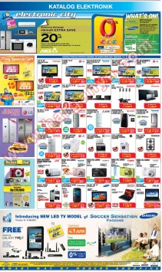
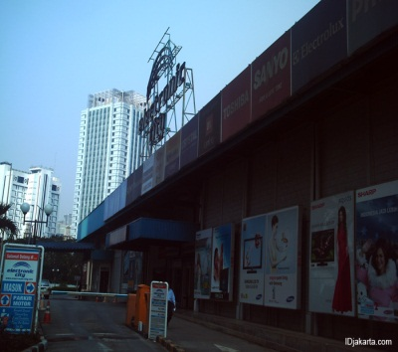
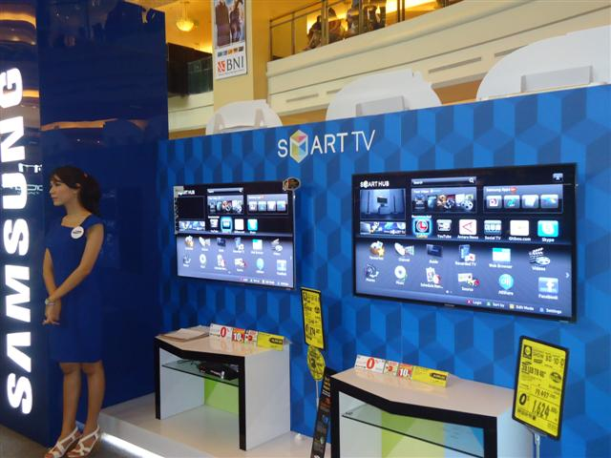

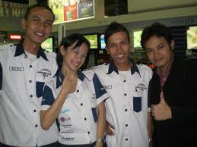
REAL STORE ILLUSTRATION

Slide 6

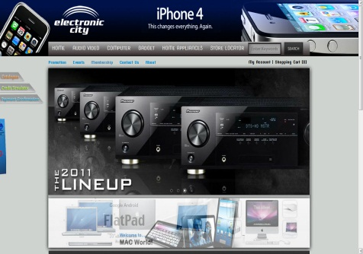
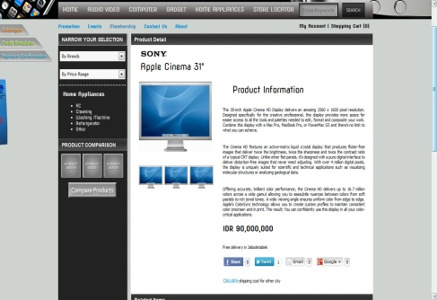

WEB STORE ILLUSTRATION

Slide 8
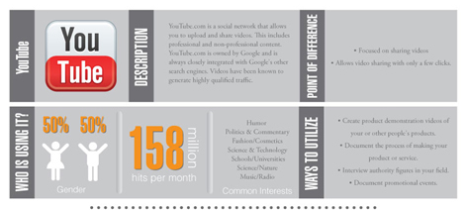

Slide 9
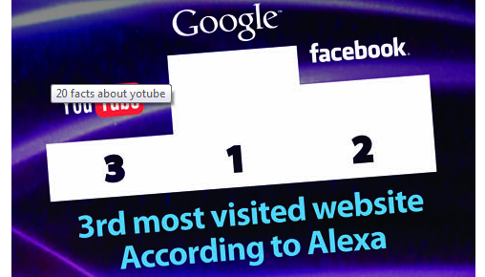

Slide 10
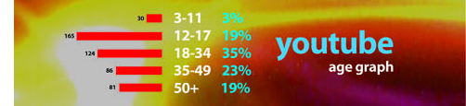

Slide 11
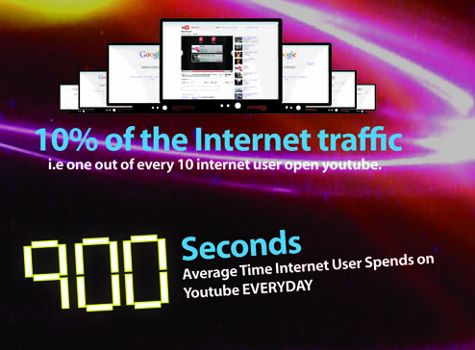

Slide 12
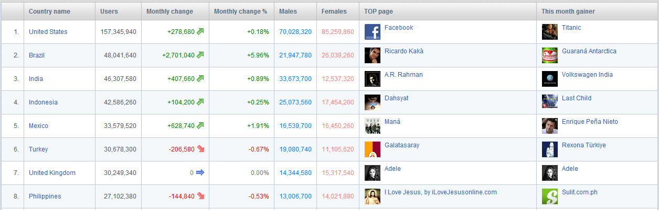

Slide 13

YOUTUBE ONLY
VIDEO SHARING

Slide 14
YOUTUBE IS ABOUT PROMOTING
YOUTUBE IS ABOUT BRANDING
YOUTUBE IS ABOUT
VISUAL MARKETING

Slide 15



VISUAL MARKETING
EXAMPLE
OVER 160 MILLION VIEWER,
CAN YOU FIGURE IF
THE CONVERSION RATE IS 0.1%
HOW MUCH HE MAKES?

Slide 16
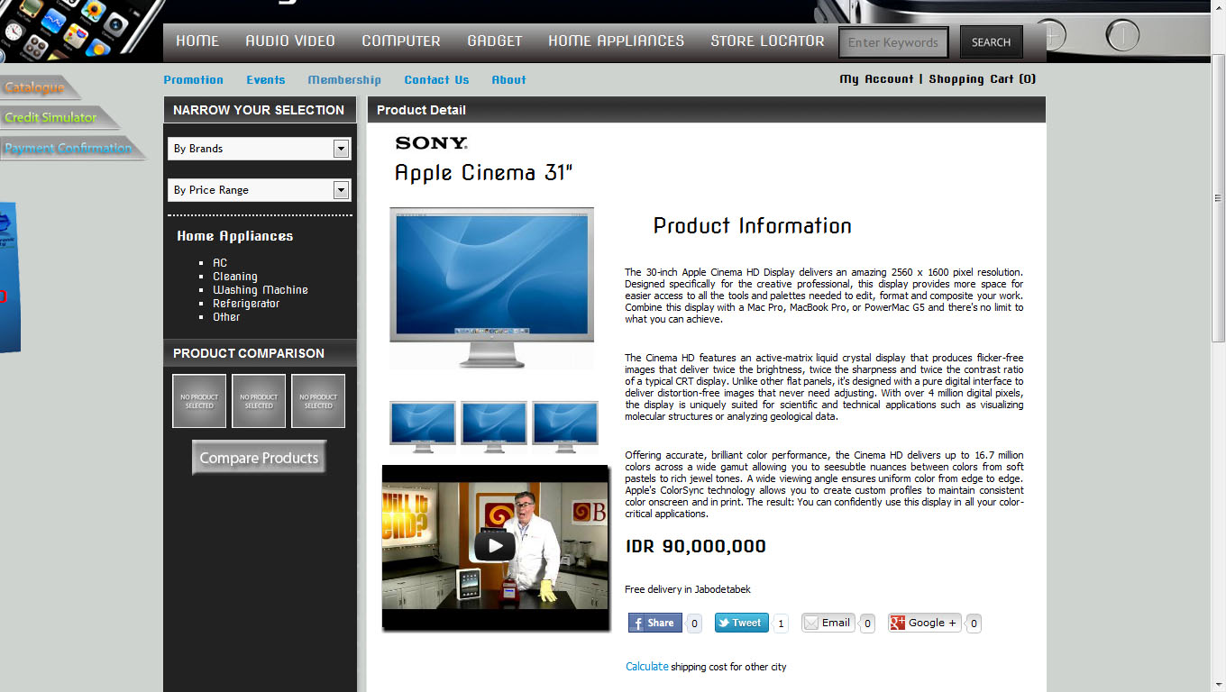
YOUTUBE VID ON DETAILS

Slide 17
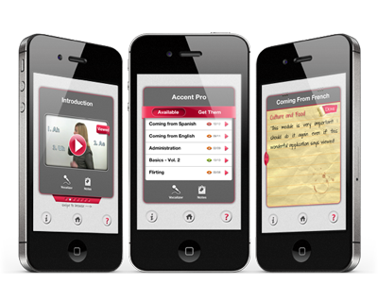
MOBILE APPS

Slide 18
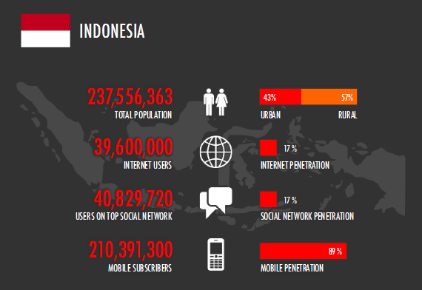
MOBILE APPS

Slide 19
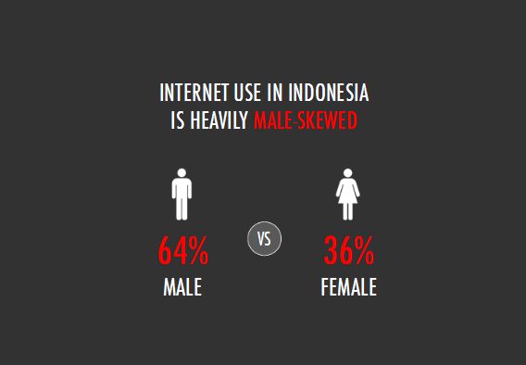
MOBILE APPS

Slide 20
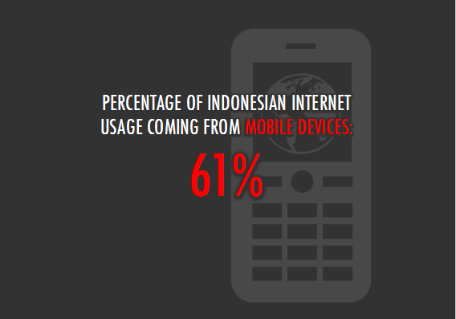
MOBILE APPS

Slide 21
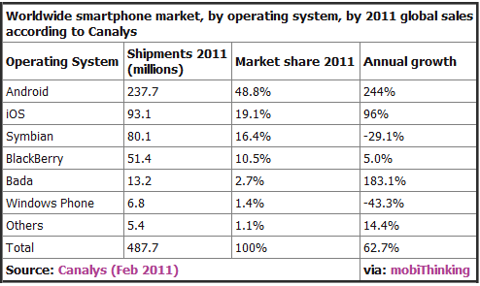
MOBILE APPS

Slide 22
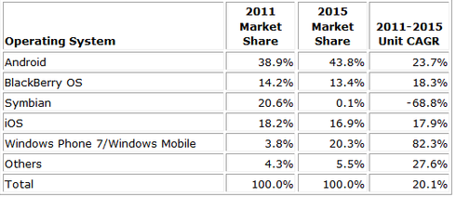
MOBILE APPS

Slide 23
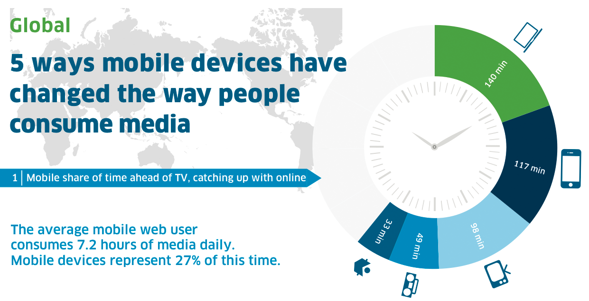
MOBILE APPS

Slide 24
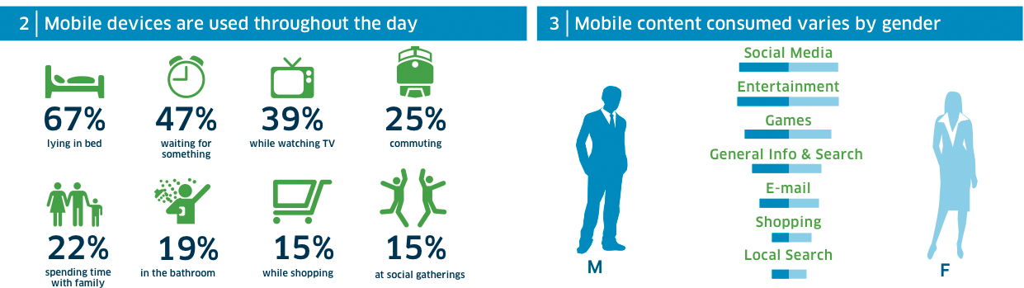
MOBILE APPS

Slide 25
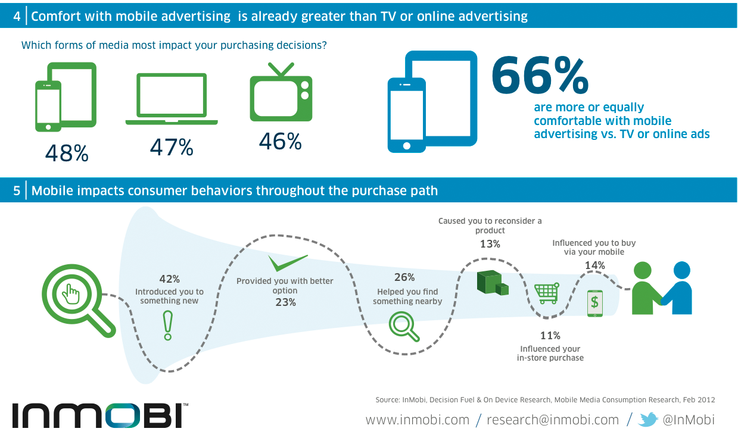
MOBILE APPS

Slide 26
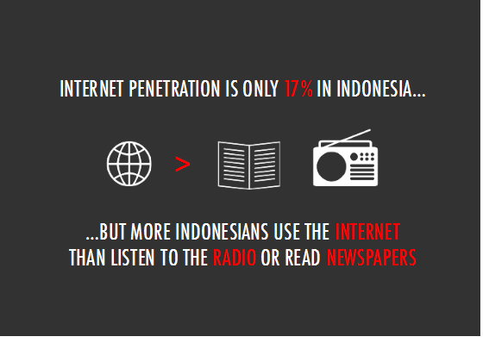
MOBILE APPS

Slide 27
WEB - COMMERCE
CMS RELATED WITH :
COMMERCIAL
FINANCE
LOGISTIC
MARKETING

Slide 28
E_COMMERCE SOFT LAUNCH
ELECTRONIC-CITY.NET
14th JUNE – 2012
MEETING INTERNAL
8th JUNE - 2012

Slide 29


